Slide 1
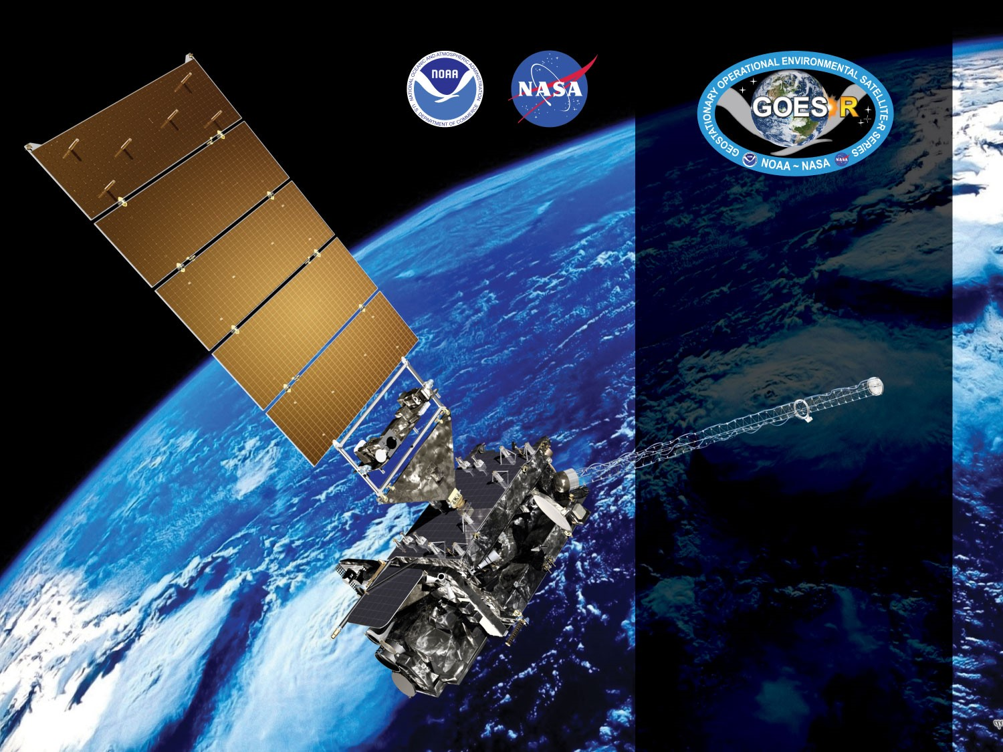
GOES-16 ABI L2+ Cloud Top Parameters Height/Temperature/
Pressure Provisional PS-PVR
FEB 16, 2018
Andrew Heidinger*, Denis Botambekov,
Jay Hoffman, Yue Li, William Straka,
Steve Wanzong
GOES-R AWG
NOAA/NESDIS/STAR*
CIMSS

Slide 2
Agenda
Review of Beta Maturity
Provisional Validation Product Maturity Assessment
East location is shown
Central assessment in Backups section
National Weather Service Perspective
Path to Full Validation Maturity
Summary and Recommendations

Slide 3
Review of Beta Maturity
GOES-16 Cloud Top Parameters L2 Product Provisional PS-PVR

Slide 4
PLPTs Under Review
BETA
PLPT ID | Descriptive Title | % Complete | Results | AWG POC
ABI-FD_CTH/CTT/CTp01 | Verify Product is generated every 15 min for FD for M3 | 100 | Complete | PRO
ABI-CONUS_CTH/CTp01 | Verify Product is generated every 5 min for CONUS for M3 | 100 | Complete | PRO
ABI-MESO_CTH/CTT01 | Verify Product is generated every 5 min for Meso for M3 | 100 | Complete | PRO
ABI-FD_CTH/CPP/CTp02 | Verify Product is generated every 5 min for FD for M4 | 100 | Complete | PRO
ABI-CONUS_CTH/CTT02 | Verify Product is generated every 5 min for CONUS for M4 | 100 | Complete | PRO
ABI-FD_CTH/CTT/CTp03 | Quantitative analysis of M3 FD CTP | 100 | Complete | AWG
ABI-CONUS_CTH//CTp03 | Quantitative analysis of M3 CONUS CTP | 100 | Complete | AWG
ABI-MESO_CTH/CTT02 | Quantitative analysis of M3 Meso CTP | 100 | Complete | AWG
PS-PVR BETA granted on May 16, 2017
Notes:
Page 3 states the first 5 are verified by OSPO, even though the Appendix A mentions AWG team members.
7th event is listed as ABI-CONUS_CTH/CTT/CTp03 on page 4. The Appendix only lists CTH/CTp.
No CTT product for CONUS in Mode 3.
No CTp product for mesoscale in Mode3, and no CONUS in mode 4.

Slide 5
Cadence for verification
Mode | Mode 3 |  |  | Mode 4
Scan Type | FD | CONUS | MESO | FD | CONUS | MESO
Scan Freq | 15 min | 5 min | 30 sec | 5 min | 5 min | N/A
CTH - Ver Freq | 15 min | 5 min | 5 min | 5 min | 5 min | N/A
CTp - Ver Freq | 15 min | 5 min | N/A | 5 min | N/A | N/A
CTT - Ver Freq | 15 min | N/A | 5 min | 5 min | 5 min | N/A
Notes:
The accuracy and precision requirements for CTP apply only to daytime conditions, where solar zenith is within 62 degrees (CTH is 65). EMIS > 80 too.

Slide 6
Requirements
BETA
Ensure consistency across all sectors.
Accuracy and precision requirements for CTP apply to daytime conditions only.
Is this in error?
Solar zenith angle is within 62 degrees (65 for CTH).
No requirement for MESO CTp, but assume CONUS CTp requirements.
Notes:
The accuracy and precision requirements for CTP apply only to daytime conditions, where solar zenith is within 62 degrees (CTH is 65). EMIS > 80 too.

Slide 7
Risks to Reaching Provisional
Risk Name | Description | Impact | Mitigation and Schedule
Incorrect CRTM coefficients | The incorrect CRTM coefficients are being used in the GS. | Minor | (ADR 192) is scheduled to fix this issue and is scheduled for implementation on (5/5).
Wrong Seebor emissivity data being used | Currently the GS is using the June Seebor and MODIS white sky albedo. While the impact on the Height/Temperature/Pressure is minor, it is still an issue | Minor | WR 1828 is scheduled to fix this issue and is scheduled for implementation on June 2017. AWG will verify fix when it is available on the OE.
Missing data blocks during M4 testing | Large portions of the L1b data are missing during M4 causing large areas of “invalid” (fill) pixels | Major | This will be resolved when the ground system at NSOF switches to using RF GRB. This is scheduled to occur prior to handover.
Height underestimation for very high thin clouds | The heights of cirrus that are very thin and located at the tropopause are often underestimated especially when lower levels of cloud are present. | Minor | We will explore short-term tuning of the ACHA parameters and explore long-term solutions from the NOAA Enterprise ACHA.
Height error for low clouds | Due to low-level inversions that are often missing in NWP profiles, our low-level heights are in error. | Minor | We will tune the lapse rate parameters in the short-term.
Fixed in 2018
Discussed Later

Slide 8
Upstream Algorithm Issues
Upstream Issue | Description | Impact | Algorithm Implications
ABI L1b - INR | Issues remain with ABI L1b INR issues associated with navigation and co-registration issues | Minor | Algorithm results will be stripping due to upstream algorithm issues at cloud edges
ABI L1b - Stripping | Image stripping is present in some imagery data | Minor | Algorithm results will be stripping due to upstream algorithm issues as well as due to direct L1b usage
ABI L1b - Calibration Issues | Calibration is still being evaluated on the system
ABI L1b - GRB | Missing blocks of data in M4 due to terrestrial GRB issues | Major | Algorithm will produce invalid data in regions of missing blocks
ABI L2+ - ACM | False cloud tends to result in low “stationary” clouds. | Minor | Algorithm produces false low level cloud
Fixed
Improved
Notes:
Prior to November 21, RMFMT update, 4% of distribution was false low clouds. Post update, in 2018 show 3% of the distribution was false low clouds.

Slide 9
Provisional Validation Product Maturity Assessment
GOES-16 Cloud Top Parameters L2 Product Provisional PS-PVR

Slide 10
Requirements for FULL Validation
CTH: Accuracy 500 m; Precision 1500 m, for all clouds with EMIS > 0.8. All sectors.
CTp: Accuracy 50 hPa; Precision 150 hPa, for all clouds with EMIS > 0.8. All sectors.
CTT: Accuracy 3 K; Precision 5 K, for all clouds with EMIS > 0.8. All sectors.

Slide 11
PLPTs Under Review
PROVISIONAL
PLPT ID | Descriptive Title | % Complete | Results | AWG POC
ABI-FD_CTH/CTT/CTp04 | Quantitative analysis of M3 FD CTP | 100 | Complete | AWG
ABI-CONUS_CTH/CTp04 | Quantitative analysis of M3 CONUS CTP | 100 | Complete | AWG
ABI-MESO_CTH/CTT03 | Quantitative analysis of M3 Meso CTP | 100 | Complete | AWG

Slide 12
Requirements
PROVISIONAL
Assess the accuracy and precision requirements for CTp.
Document impacts with upstream dependencies (Derived Motion Winds).
All ABI modes must meet horizontal, mapping, and range requirements.
If accuracy and precision are not met, document reasons why as an ADR.
Remediation strategies in place.
Product ready for potential operational use.
Notes:
Solar zenith is within 62 degrees (CTH is 65). EMIS > 80 too.

Slide 13
PLPT Tests for each Domain
Our 3 quantitative PLPTs dealing with analysis are comprised of the same 5 methods.
Each contains the applications of these methods on the FD, CONUS and MESO domains.
The applications of each method to each domain is summarized below.
Some methods were redundant or not possible for some domains.
Analysis Method | FD | CONUS | MESO
Visual Inspection
Comparison to other Clouds (MODIS+VIIRS)
ARM
CALIPSO Lidar Comparison
Notes:
ARM data is only over CONUS, we found no reason to repeat with FD
We used tight-time constraints for MODIS comparisons and no MESOS or CONUSs were found.
MESO images that are in-sync with CALIPSO are rare.
MESO domains over ocean where not found.
No reason to repeat CALIPSO FD analysis on CONUS.

Slide 14
Qualitative Success Definitions
PASSED
Specifications are met for product cadence and creation.
PARTIAL-PASSED
Specifications are close to being met for product cadence and creation. Example: Products created with missing blocks.
FAILED
Specifications are far from being met for product cadence and creation.

Slide 15
Issues with the Data Fabric
GOES-16 Cloud Top Parameters L2 Product Provisional PS-PVR

Slide 16
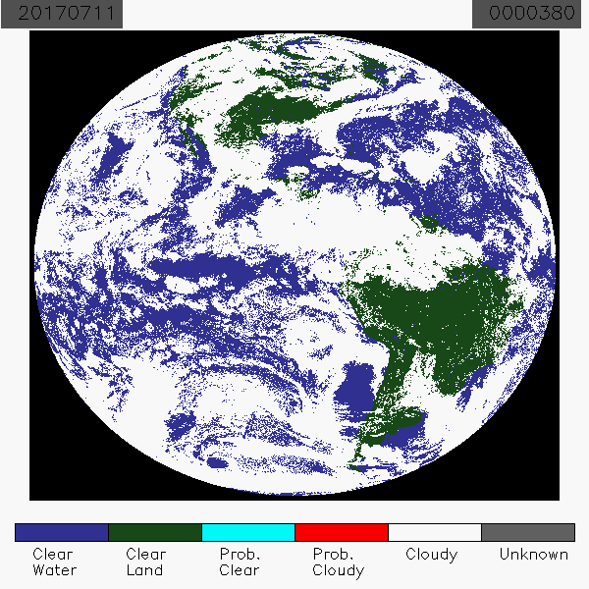
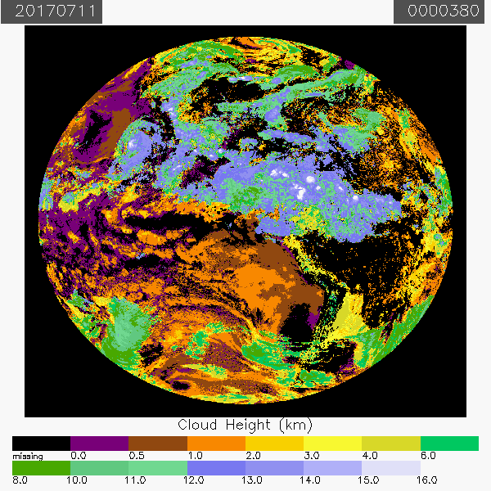
PLPT ABI-FD_CTH/CTT02:
Binary Cloud Mask
CTH Full Disk Mode 3:
July 11, 2017
All CTPs continue to exhibit occasional missing blocks of data during Mode 3 or 4.
Known issue within the data fabric.
Bad blocks within the binary cloud mask are amplified in the CTps.
Bad blocks within the CTps are not always in the binary cloud mask.
Cloud Top Height
CENTRAL
PARTIAL

Slide 17
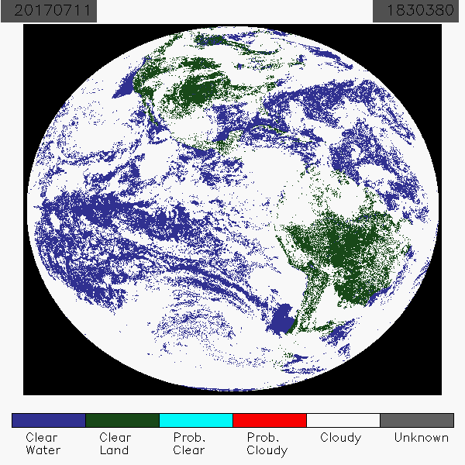
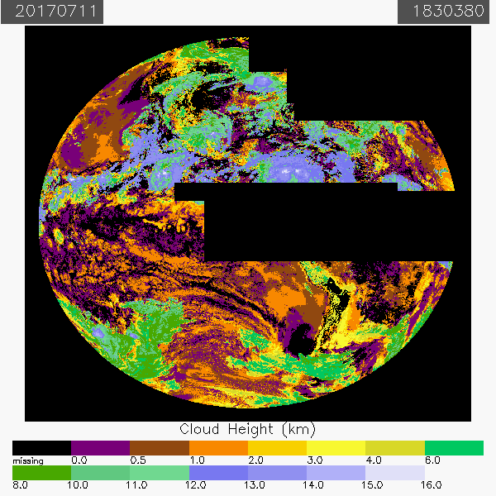
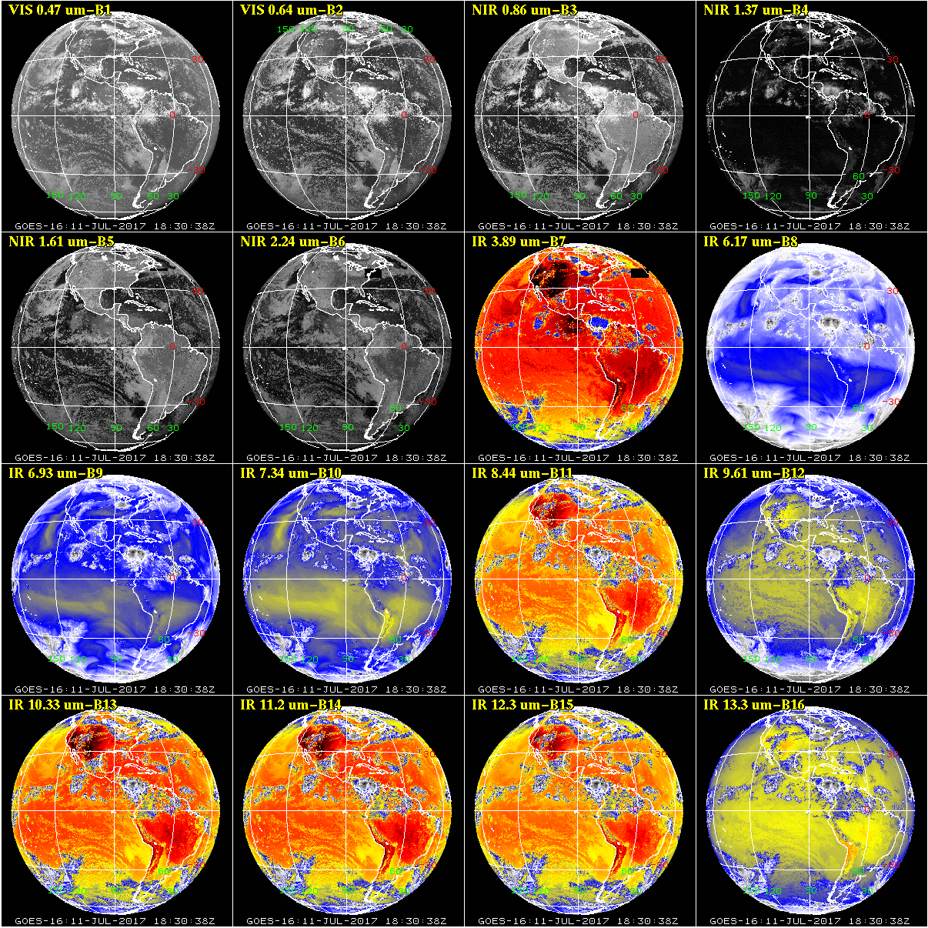
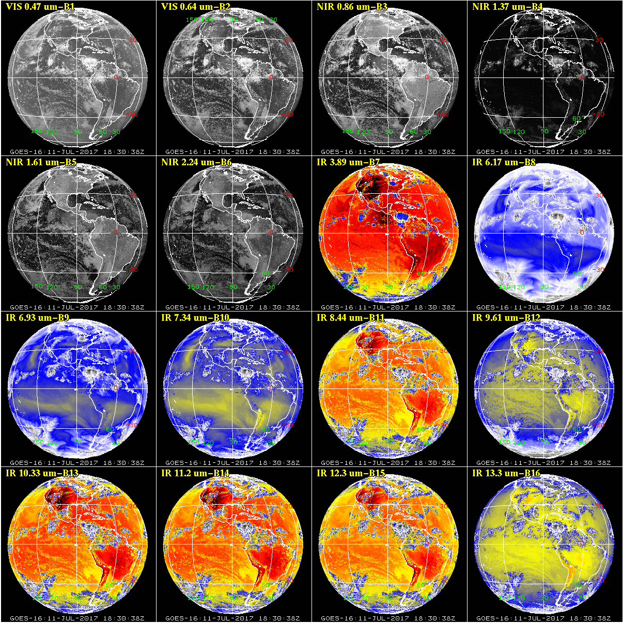
PDA GRB Comparison
Known issue where the data fabric is expiring too soon.
Not as evident in the BCM.
Possible fix in D0.06 in October 2017.
JANUARY 2018 FIXED
PDA
GRB
CENTRAL

Slide 18
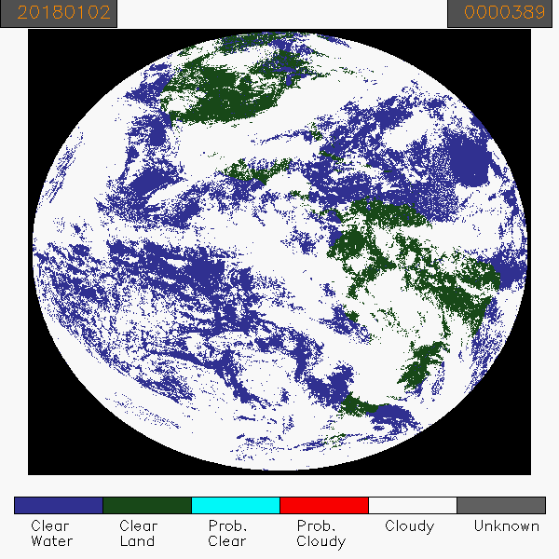
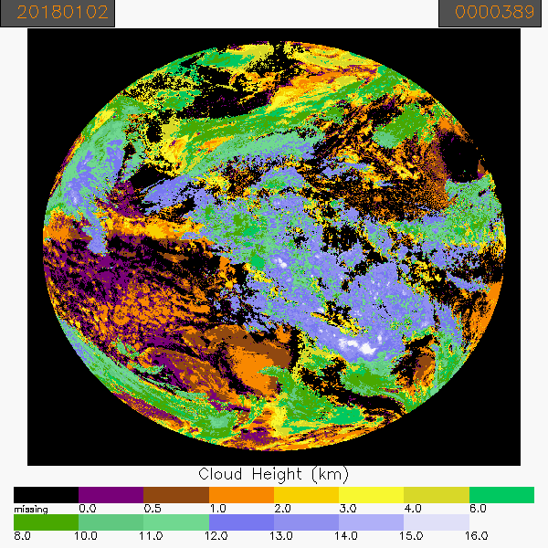
PLPT ABI-FD_CTH/CTT02:
Binary Cloud Mask
CTH Full Disk Mode 3:
January 2, 2018
Large improvement in the dropped blocks.
Entire days of FD data now have no dropped blocks.
Cloud Top Height
EAST
PASSED

Slide 19
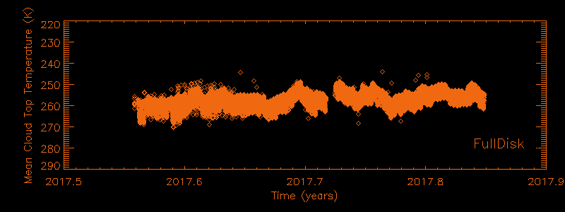
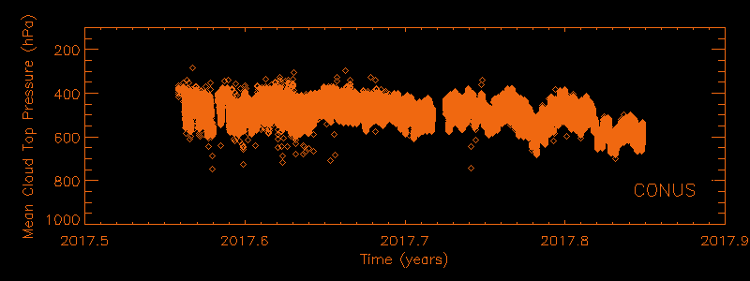
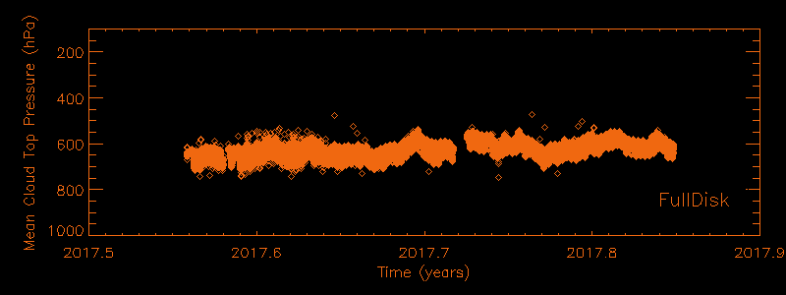
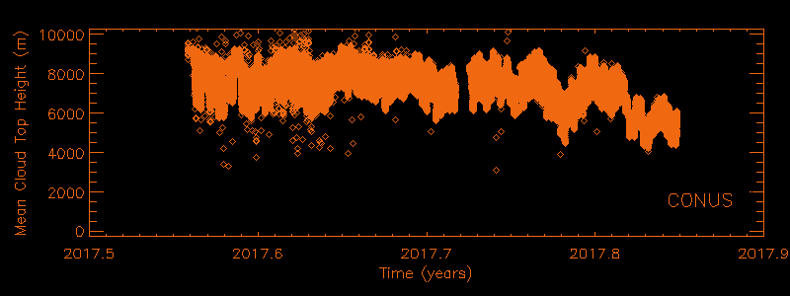
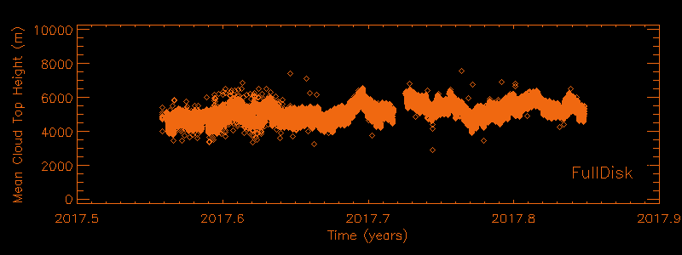
Time Series of Mean Values (Prov)
Time-series of the mean-values of Full Disk (right) and CONUS (left) data.
Time period is July 24 - Nov 6 2017.
Some missing data evident.
No CTT on CONUS.
CENTRAL
CTT
CTp
CTp
CTH
CTH
CENTRAL
PASSED

Slide 20
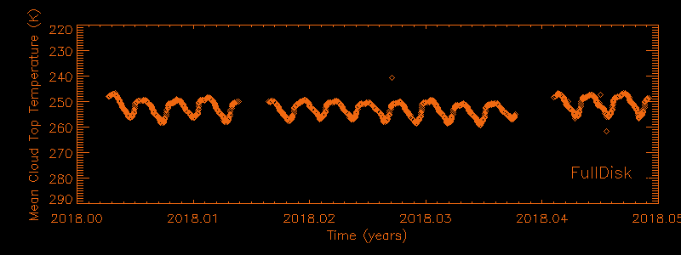
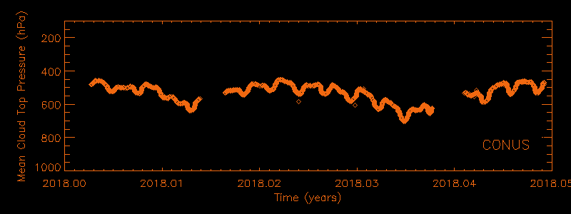
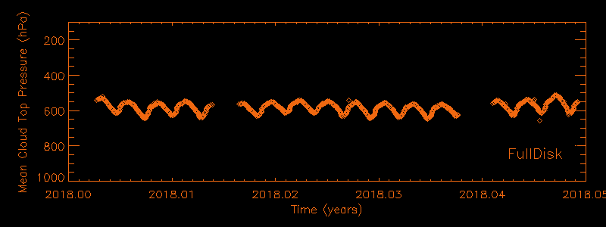
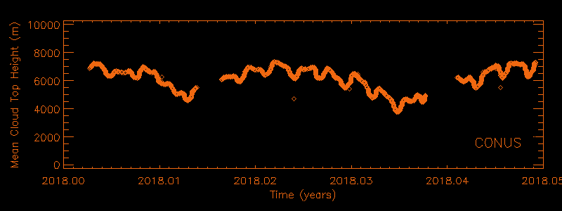
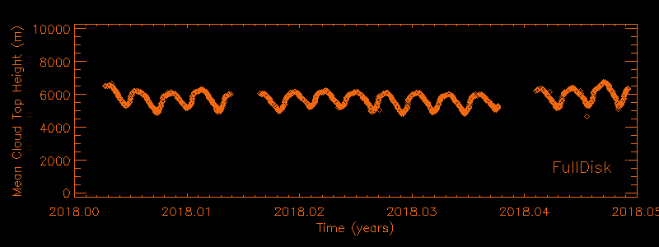
Time Series of Mean Values (Prov)
Time-series of the mean-values of Full Disk (right) and CONUS (left) data.
Time period is Jan 2 to Jan 18, 2018.
Some missing data evident.
No CTT on CONUS.
EAST
CTT
CTp
CTp
CTH
CTH
EAST
PASSED

Slide 21
Quantitative Success Definitions
PASSED
Specifications are met for single-layer clouds* with COD > 1* and where the phase matches that of the “truth” data. These assumptions are consistent with the cloud retrieval model.
PARTIAL-PASSED
Specifications are close to being met for single-layer clouds with COD > 1 and where the phase matches that of the “truth” data.
FAILED
Specifications are far from being met for single-layer clouds with COD > 1 and where the phase matches that of the “truth” data.
*COD > 1 is a limit in the L1RD (aka e_{c} > 0.8). Only CALIPSO/CALIOP analysis uses COD. MODIS analysis is without COD and without single layer restriction.

Slide 22
Comparison with the NASA MODIS Cloud Top Parameters
GOES-16 Cloud Top Parameters L2 Product Provisional PS-PVR

Slide 23
MODIS Cloud Height Comparison Format
We looked for AQUA/MODIS Scenes within 2 minutes of GOES-16.
We used CGMS navigation tools to map GOES-16 into the MODIS swath.
We don’t expect perfect agreement at the pixel scale so these results are more qualitative.
Phase image shown for reference. GOES-16 Phase has large impact on GOES-16 Height EDRs.
NASA MODIS C6 MYD35 Cloud Phase
NASA MODIS C6 MYD35 EDR
GOES-16 False Color Mapped to MODIS Swath
GOES16 Cloud Phase
GOES-16 EDR
Scatter plot of GOES-16 EDR versus NASA EDR

Slide 24
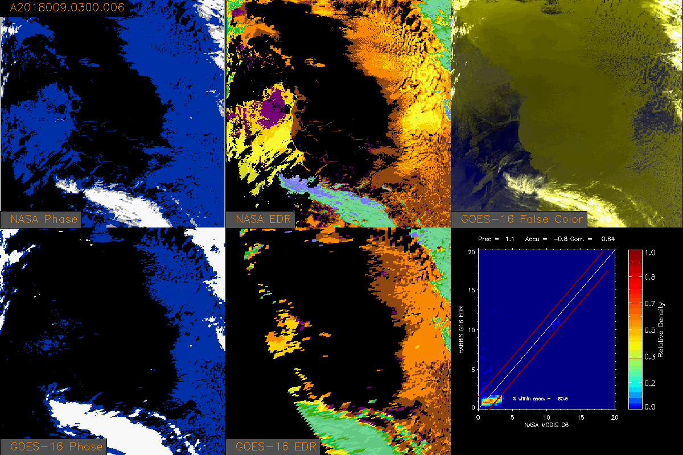
Cloud Top Height (2018/009)
EAST

Slide 25
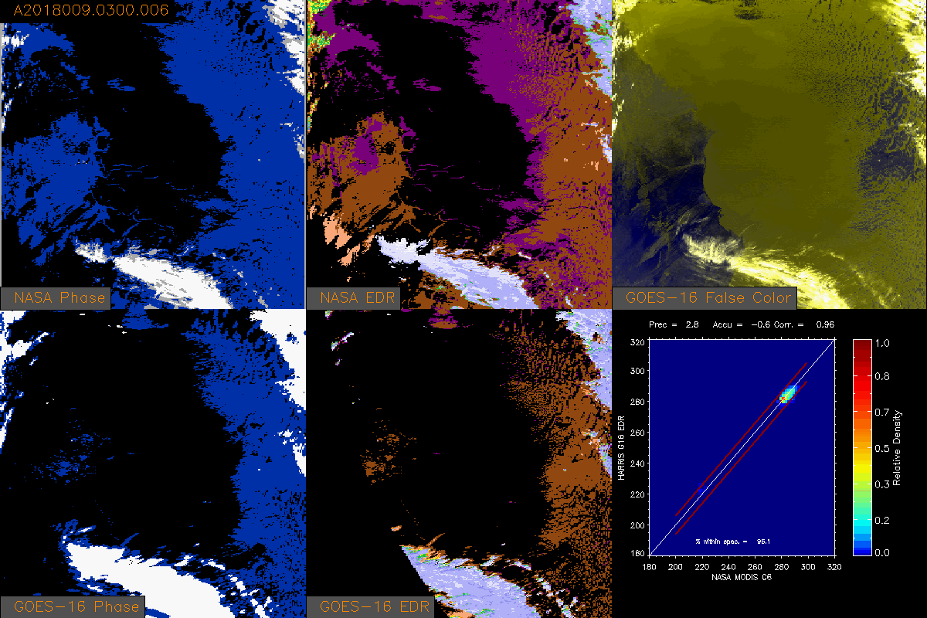
Cloud Top Temperature (2018/009)
EAST

Slide 26
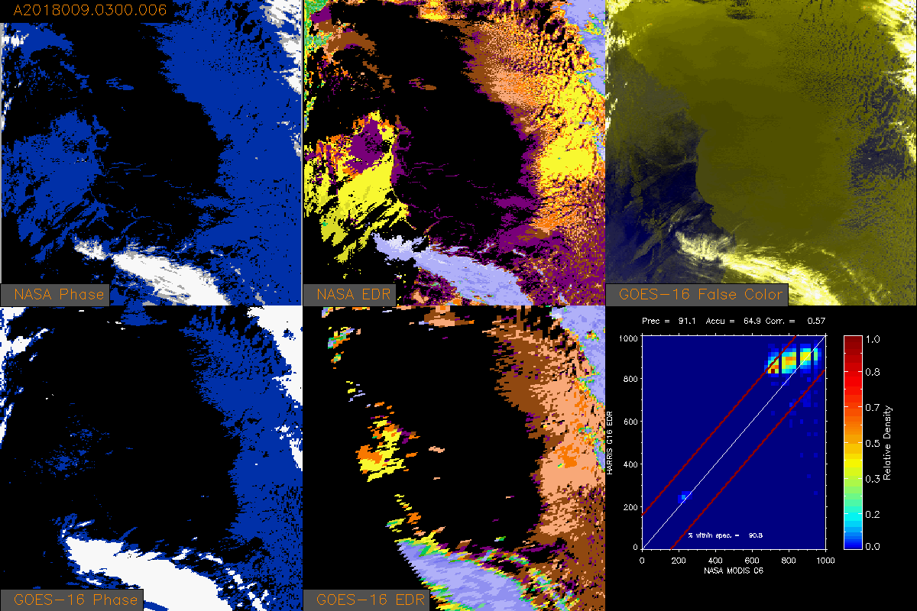
Cloud Top Pressure (2018/009)
EAST

Slide 27
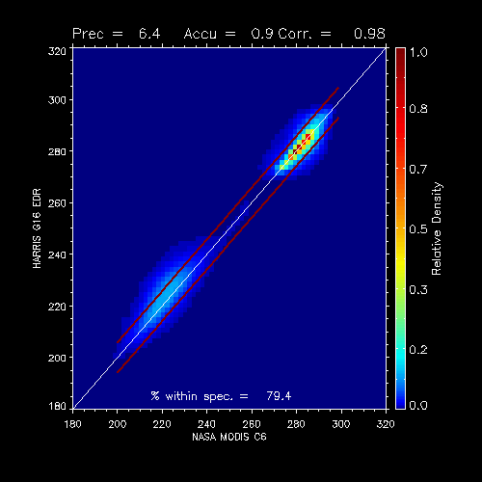
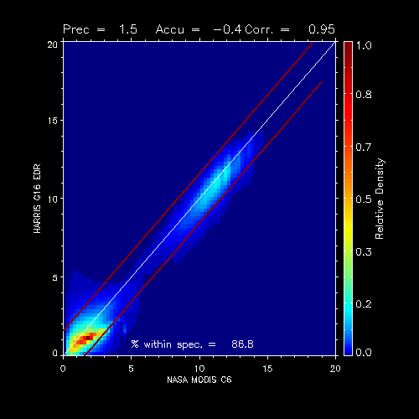
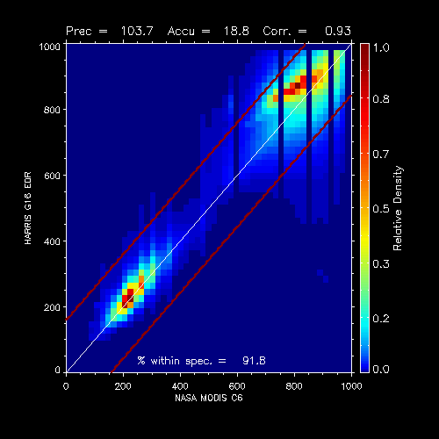
Summary of GOES-16 vs MODIS
Combined scatter-plots are shown below for all co-incident scenes.
12 days of data: 2018_002 – 005; 007-013; 016.
Applied emissivity > 0.8 and GOES-16 and MODIS both cloudy and same phase.
Accuracy and Precision spec nearly met for all 3.
Following APU logic, % within spec are 79.4, 86.8 and 91.8 for CTT, CTH and CTP. U = Uncertainty = SQRT(A**2 + P**2)
PARTIAL
PASSED
PASSED
PASSED
CTT
CTH
CTP
EAST
EAST

Slide 28
Comparison to NASA CALIPSO/CALIOP Cloud Height
GOES-16 Cloud Top Parameters L2 Product Provisional PS-PVR

Slide 29
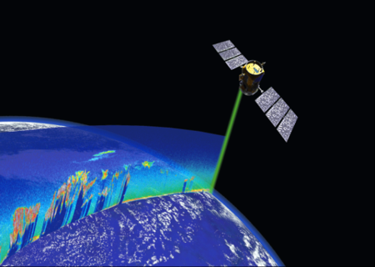
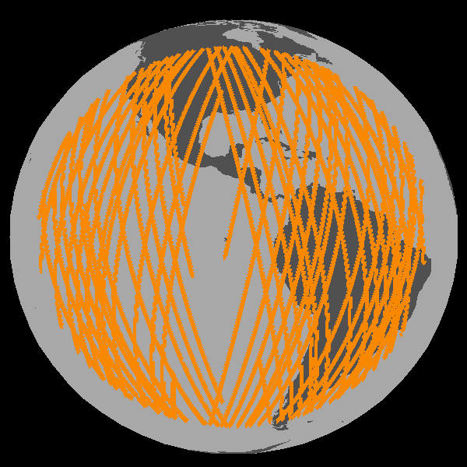
CALIOP vs ABI Comparison Description
CALIOP is a lidar on board of CALIPSO.
CALIOP Cloud Layer (5 km + 1 km) data results are considered as “Truth”.
COD = column optical depth
Height, Temperature, Pressure = value of highest cloud layer adjusted for IR weighting function.
5 km Cloud Layer Product is supplemented with 1 km Cloud Layer Product
11 days of CALIOP and ABI Matchup data are used 2018-002 - 2018-013, and contains of mix of M3 and M4.
Filters applied to GOES-16:
Scan time difference ± 12 minutes,
Sensor Zenith Angle < 62.0
Filters applied to CALIOP
90N - 90S
COD > 1.0 (Emiss > 0.8)
5km cloud fraction 0 or 1 (to avoid edges of cloud)
https://www.globe.gov/web/calipso
EAST

Slide 30
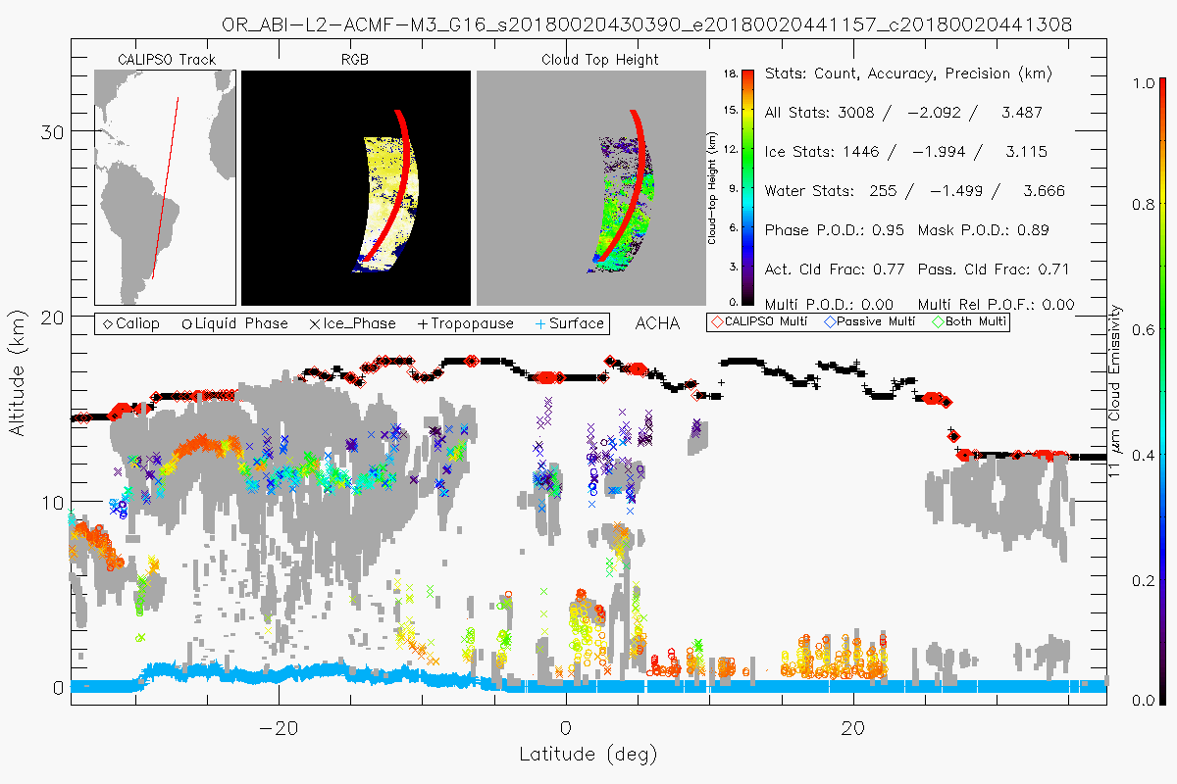
Cross Section of GOES-16 CTH with CALIOP Cloud Layers
Mission of ACHA is to assign a single representative height to clouds that are often optically thin, span many kilometers and are comprised of multiple layers.
EAST

Slide 31
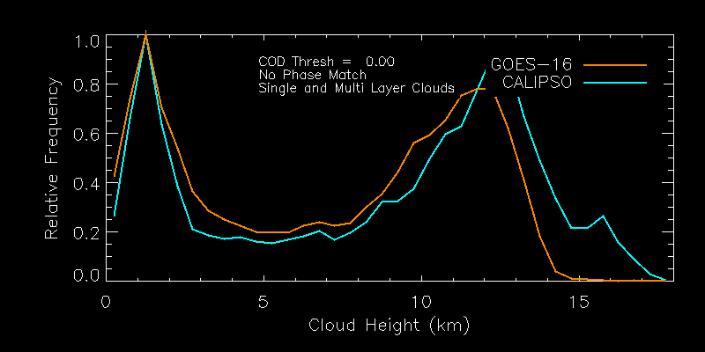
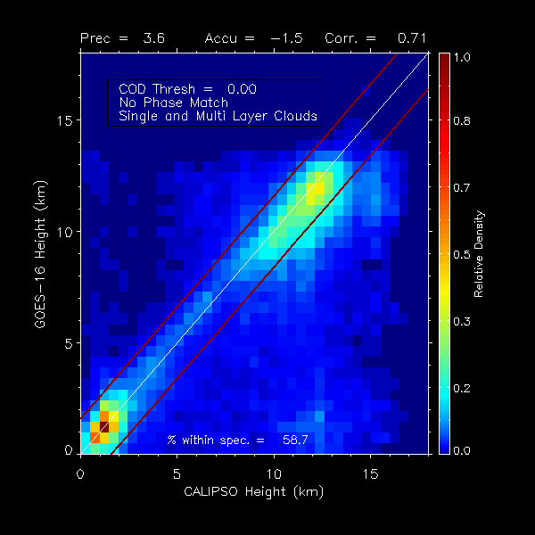
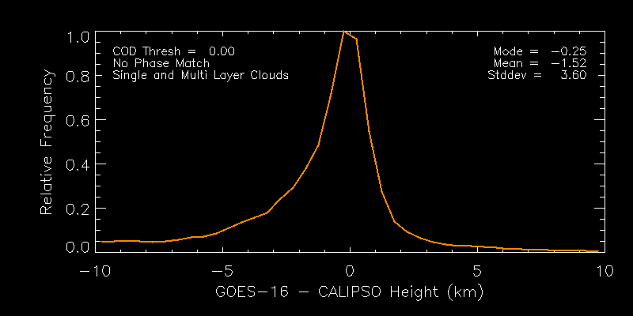
Cloud Top Height (No Filter)
Mode of bias within +/- 0.5 km spec.
0.59 of clouds meet spec.
Underestimate height of very highest clouds (near tropopause)
Specs FULL
Accuracy = 0.5 km
Precision = 1.5 km
EAST
PARTIAL

Slide 32
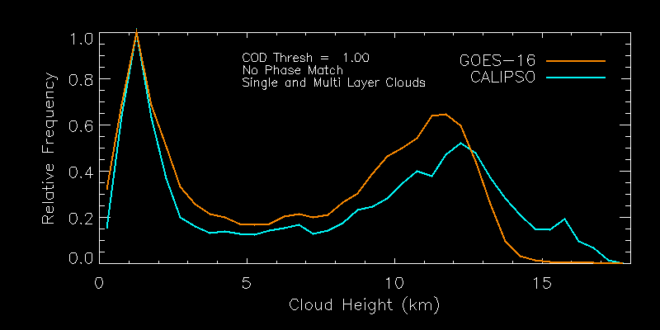
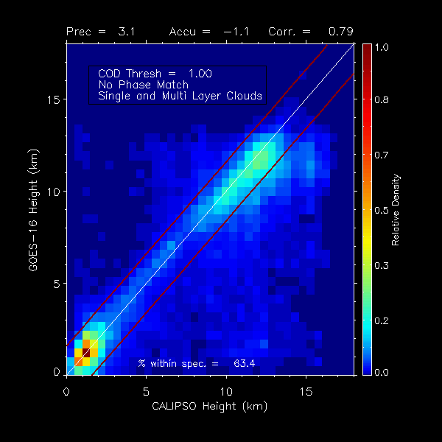
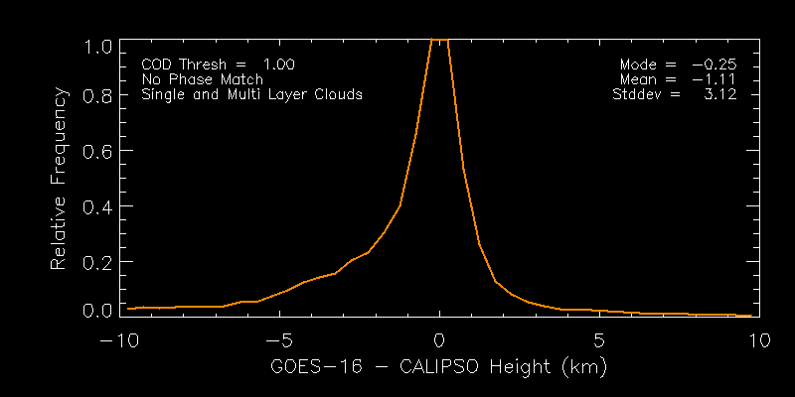
Cloud Top Height (COD Filter)
Mode and Mean of bias within +/- 0.6 km spec.
Accuracy and Precision outside of spec.
0.63 of clouds meet spec.
Underestimate height of very highest clouds (near tropopause)
Specs FULL
Accuracy = 0.5 km
Precision = 1.5 km
EAST
PARTIAL

Slide 33
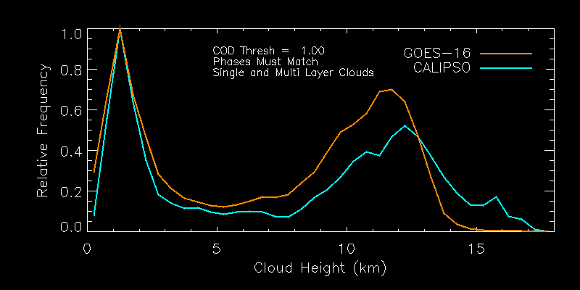
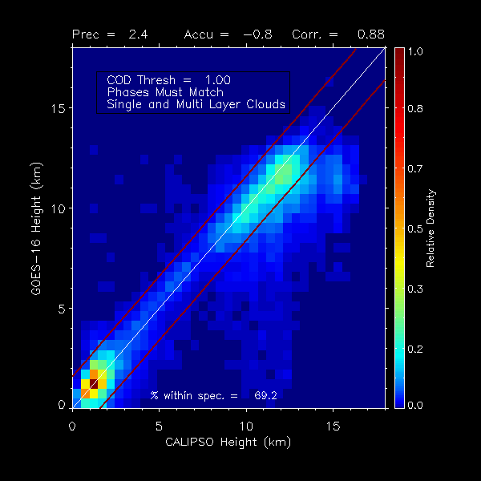
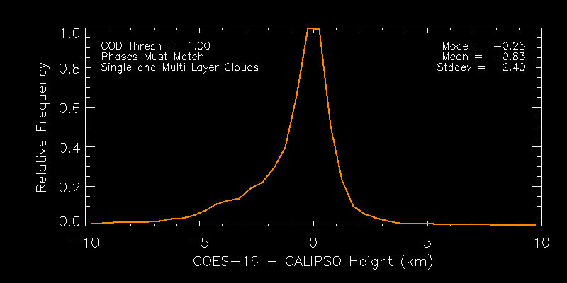
Cloud Top Height (COD, Phase Filter)
Mode and Mean of bias within +/- 0.5 km spec.
Accuracy and Precision outside of spec.
0.69 of clouds meet spec.
Underestimate height of very highest clouds (near tropopause)
Specs FULL
Accuracy = 0.5 km
Precision = 1.5 km
EAST
PARTIAL

Slide 34
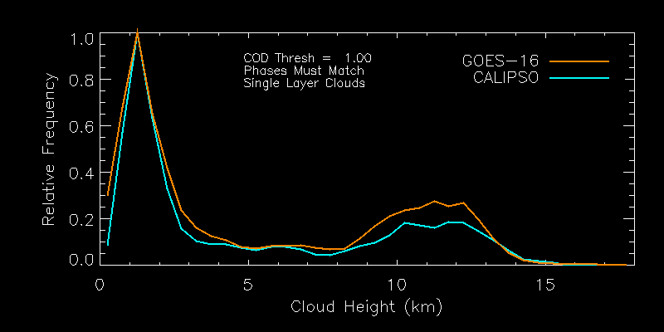
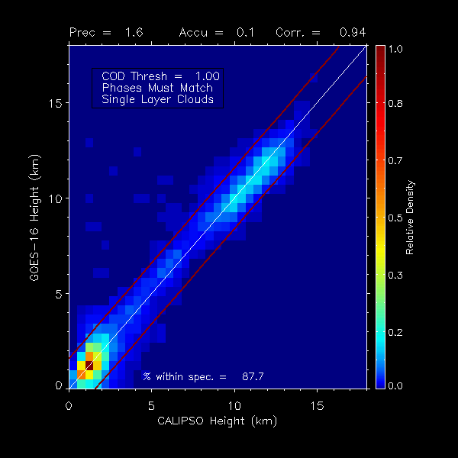
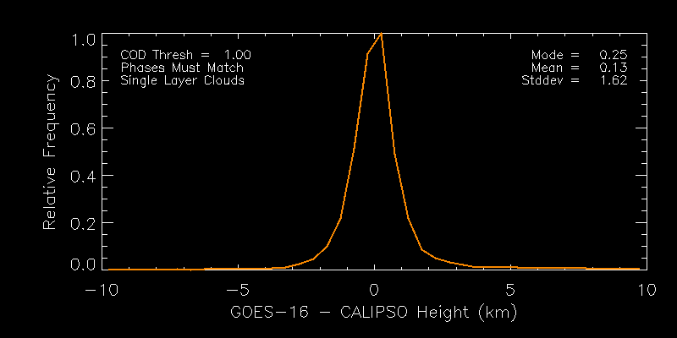
Cloud Top Height (All Filters)
Mode and Mean of bias within +/- 0.5 km spec.
Precision of entire distribution 1.6 km > 1.5 km spec.
0.88 of clouds meet spec.
Underestimation of highest clouds go away.
Specs FULL
Accuracy = 0.5 km
Precision = 1.5 km
EAST
PARTIAL

Slide 35
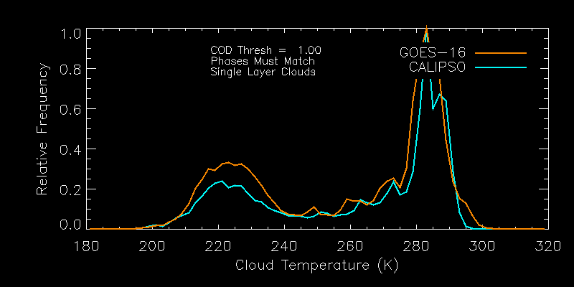
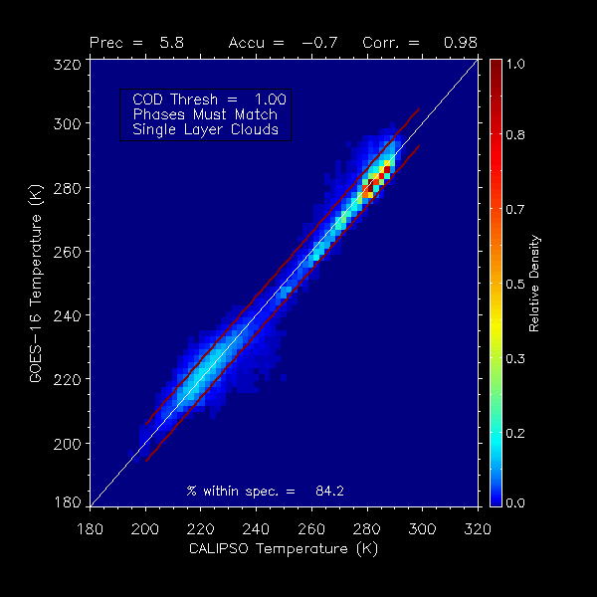
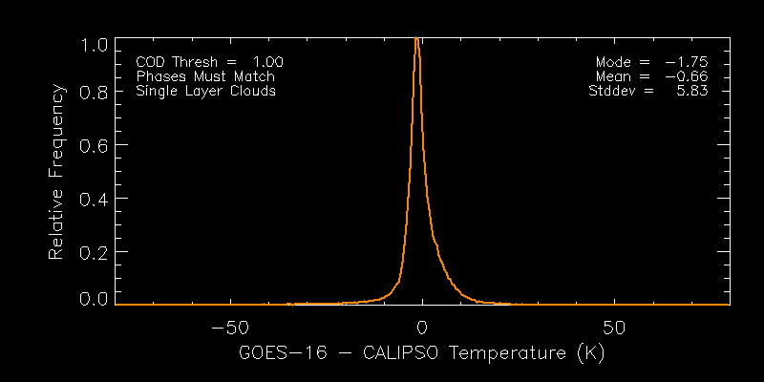
Cloud Top Temperature (All Filters)
Mode of bias peak within +/- 3 K spec.
Negative of Mean driven by small bias in low clouds.
0.84 of clouds meet spec.
Specs FULL
Accuracy = 3 K
Precision = 5 K
EAST
PARTIAL

Slide 36
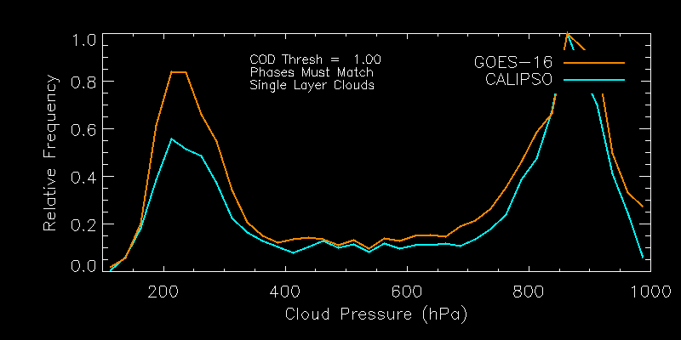
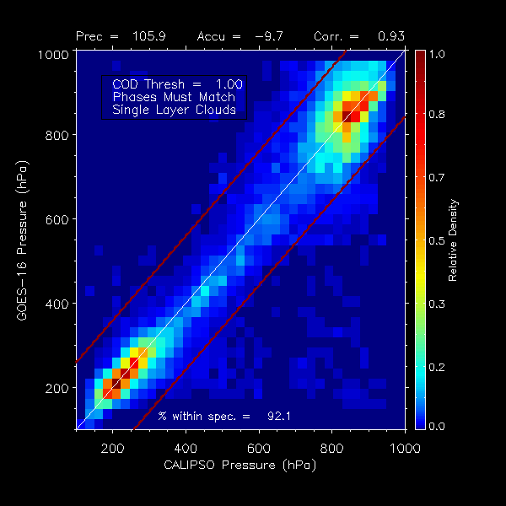
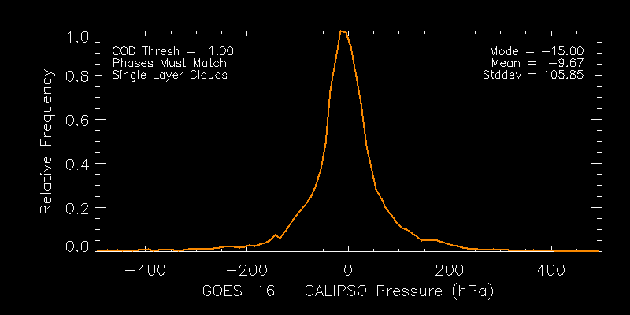
Cloud Top Pressure (All Filters)
Mode and Mean of bias within +/- 50 hPa spec.
Accuracy and Precision within spec.
92.1 % within APU spec.
Underestimate height of very highest clouds (near tropopause)
Specs FULL
Accuracy = 50 hPa
Precision = 150 hPa
EAST
PASSED
Notes:
Plot is the same as slide 33. Need plot to match the histograms.

Slide 37
Impact of Filters on Cloud Top Pressure Performance
Pressure chosen since it is used for AMV Application
Specs FULL
Accuracy = 50 hPa
Precision = 150 hPa
Filter | Count / Fraction | Accuracy (hPa) | Precision (hPa) | % within APU
None | 265507/ 1.0 | 77 | 205 | 77
Cod > 1 | 179860 / 0.68 | 51 | 172 | 81
Phase * | 145441 / 0.55 | 32 | 129 | 88
Single | 82665 / 0.31 | -10 | 106 | 92
Cod + Single | 96793/ 0.36 | -16 | 119 | 90
Phase + Single | 112263 / 0.42 | 12 | 140 | 89
This analysis shows phase meets spec. However, phase errors have a large impact on ACHA accuracy.
APU values vary greatly among Height, Temperature and Pressure. Pressure has the loosest specs.
Phase+Single Filter May be most relevant for AMV Application.
EAST
PASSED

Slide 38
CALIPSO Conclusions
For the scenarios which are consistent with the retrieval assumptions (single layer, known phase), the Baseline ACHA works.
As we include clouds that are inconsistent with the retrieval model, performance worsens (phase mismatch, multi-layers).

Slide 39
DOE ARM
GOES-16 Cloud Top Parameters L2 Product Provisional PS-PVR

Slide 40
ARM Analysis
DOE ARM provides surface-based LIDAR and RADAR measurements at the central site (Oklahoma) and at various sites around the world.
We view ARM as a backup to the space-borne LIDARs (CALIPSO, CATS, EARTHCARE).
Due to the health of CALIPSO, we do not rely on ARM data at this time.

Slide 41
ARM vs GOES-16 Comparison
January 2018
Single layer ARM retrieval.
ARM height less than 10 km.
ARM is a 5 minute average closest to GOES-16 image start time.
Day of Year
EAST
Notes:
MPL tend to report lower cloud top height as it is a surface based lidar;
Its number of layers flag tends to underestimate the layers, leaving its cloud top height estimation from lower levels.

Slide 42
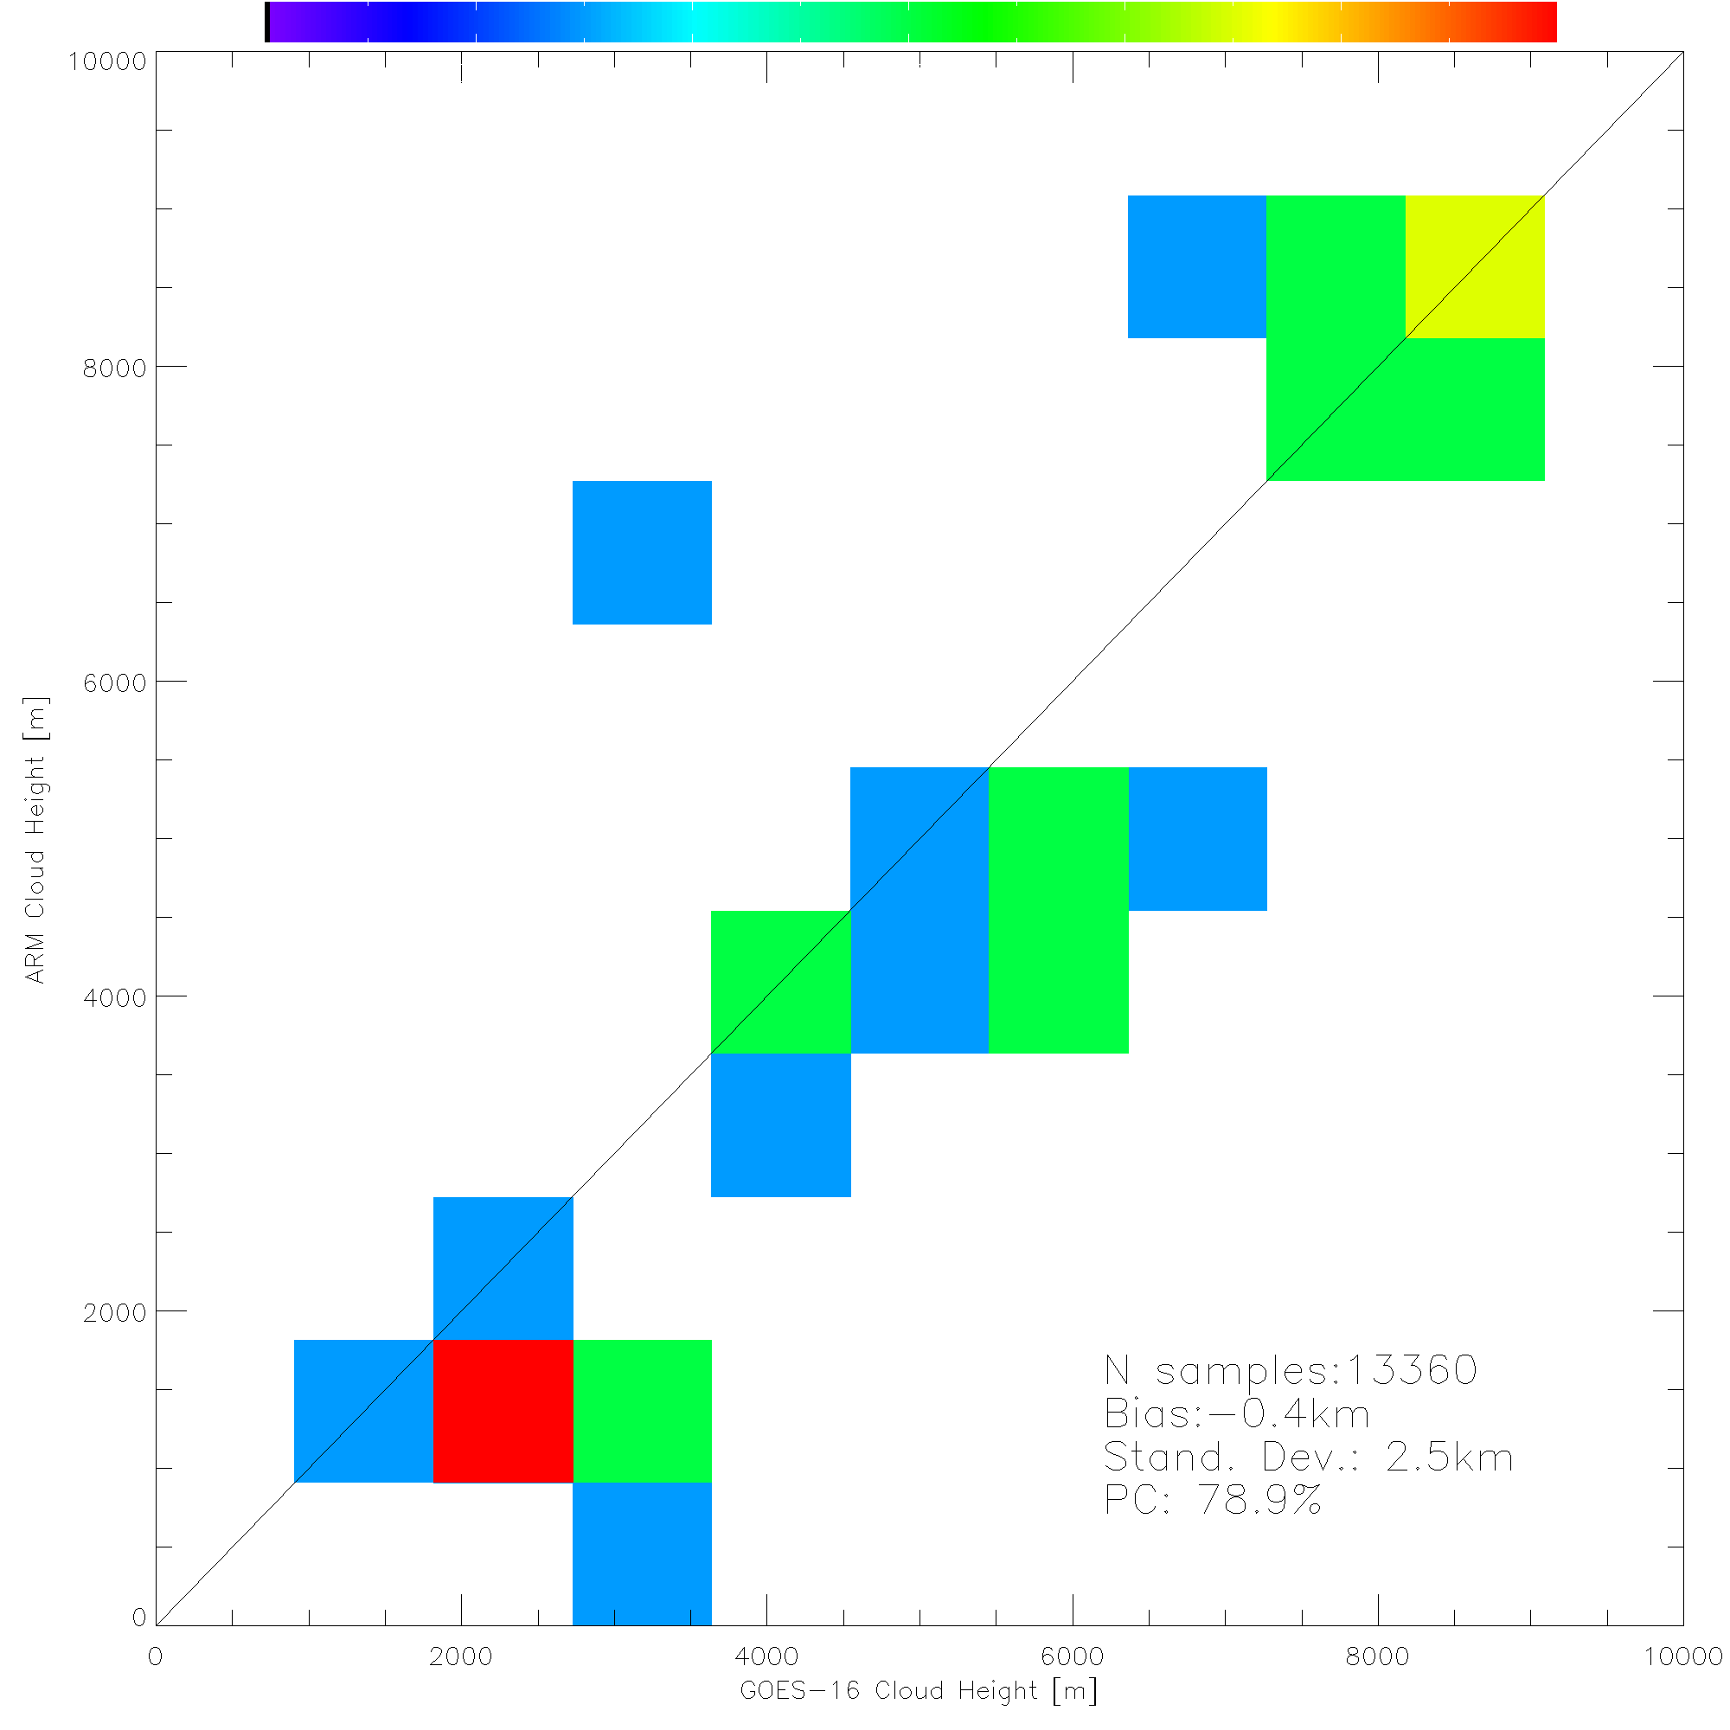
ARM vs GOES-16 Statistics
January 2018
Single layer ARM retrieval.
ARM height less than 10 km.
ARM is a 5 minute average closest to GOES-16 image start time.
EAST
Notes:
MPL tend to report lower cloud top height as it is a surface based lidar;
Its number of layers flag tends to underestimate the layers, leaving its cloud top height estimation from lower levels.

Slide 43
DMW Analysis
GOES-16 Cloud Top Parameters L2 Product Provisional PS-PVR

Slide 44
Attempts to address DMW outliers
DMW CALIPSO Analysis
Ice Model + Cirrus Changes
Cirrus Tropopause
Cirrus Uncertainty
Target 146

Slide 45
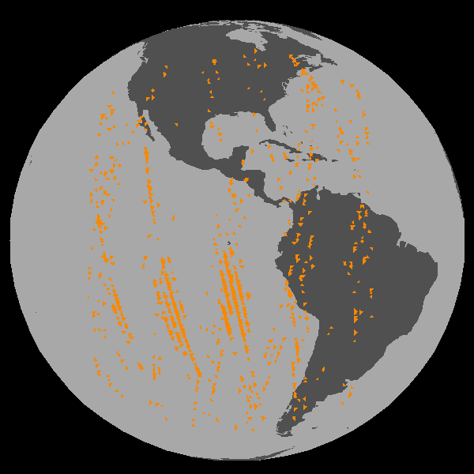
CALIOP vs DMW
CALIOP is a lidar on board of CALIPSO.
CALIOP Cloud Layer (5 km + 1 km) data results are considered as “Truth”.
COD = column optical depth
Height, Temperature, Pressure = value of highest cloud layer adjusted for IR weighting function.
5 km Cloud Layer Product is supplemented with 1 km Cloud Layer Product
16 days of CALIOP and DMWs Matchup data are used 2017-309 - 2017-324.
Filters applied to GOES-16:
Scan time difference ± 12 minutes,
Sensor Zenith Angle < 62.0
Filters applied to CALIOP
90N - 90S
COD > 1.0 (Emiss > 0.8)
5km cloud fraction 0 or 1 (to avoid edges of cloud)
https://www.globe.gov/web/calipso
CENTRAL

Slide 46
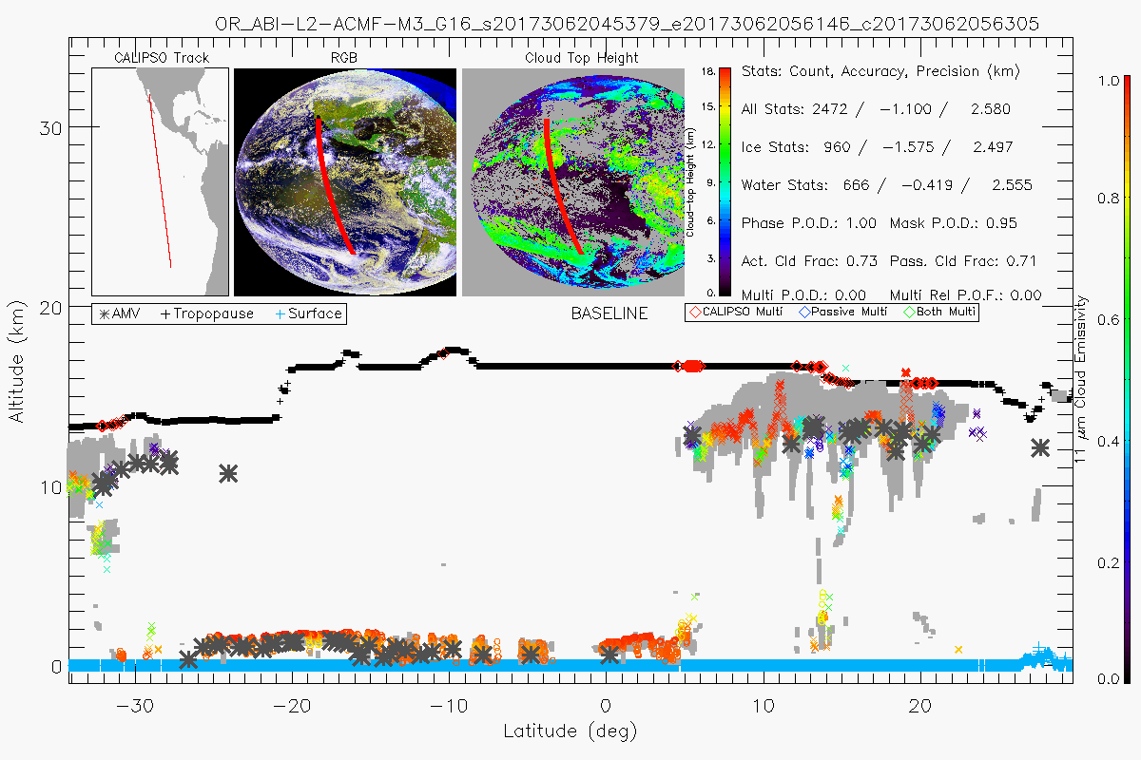
Cross Section of GOES-16 CTH/DMW with CALIOP Cloud Layers
Mission of ACHA is to assign a single representative height to clouds that are often optically thin, span many kilometers and are comprised of multiple layers.
CENTRAL

Slide 47
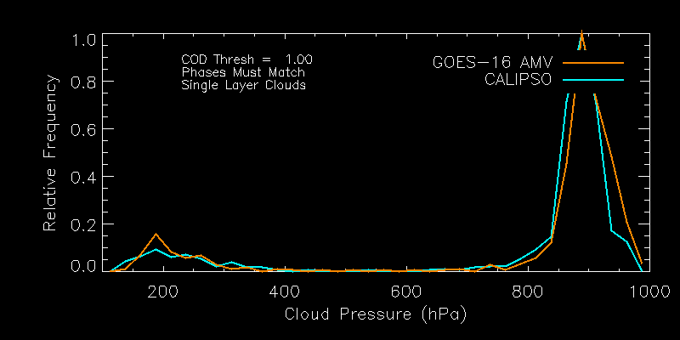
DMW Cloud Top Pressure (All Filters)
Accuracy and Precision within spec for the Height Assignment.
98.5 % of DMW heights within APU spec.
Specs FULL
Accuracy = 50 hPa
Precision = 150 hPa
609 AMVs
CENTRAL
PASSED

Slide 48
CALIPSO DMW Conclusions
For the scenarios which are consistent with the cloud retrieval assumptions (single layer, known phase), the Baseline ACHA works as an input into the DMW algorithm.

Slide 49
HOWEVER

Slide 50
GOES-16 Winds vs. Radiosonde Winds
Full Disk: November 1, 2017 – January 23, 2018
Precision Spec
(4.2 m/s)
Accuracy Spec
(7.5 m/s)
Precision Spec
(4.2 m/s)
Accuracy Spec
(7.5 m/s)
Wind Type
Band 8 (6.2um) CloudTop WV
Band 14 (11.2um) LWIR
(m/s)
Speed Bias
(AMV-Radiosonde): ………
Precision: - - - - - - -
Accuracy: ________
Precision specs not met in the 350-500 mb layer.
Negative speed bias at upper levels and positive speed bias at mid levels
indicative of sub optimal cloud height assignments.
Notes:
Band 8 wvct
P MVD SPDB SPD N STD
178.04 4.99 -0.7 15.45 72925 3.49
246.57 5.69 0.2 29.08 152188 4.02
318.9 6.92 3.09 37 34997 5.05
Band 14
P MVD SPDB SPD N STD
178.02 5.23 -1.2 15.03 57828 3.72
248.13 5.89 -1.3 27.78 129791 4.26
340.75 6.63 0.59 32.98 62865 4.93
442.86 7.11 1.96 28.32 23955 5.75
529.9 5.09 -0.3 18.69 8269 3.97
667.02 4.62 -1 11.5 7222 3.69
743.47 3.76 -0.4 10.09 10969 3.02
848.18 3.02 -0 9.71 20180 2.16
935.75 2.52 0.3 8.83 10717 1.8

Slide 51
Attempts to address DMW outliers
Vary Ice Model Habits
Aggregate columns, droxtal, empirical, hollow bullet, hollow column, large aggregate plates, plates, small aggregate plates, solid bullet, solid column, two habit.
Vary Cirrus Temperature Tropopause Offset
11, 12, 13, 14, 15, 16 K
Vary Cirrus Temperature Uncertainty
1, 5, 10, 15, 20, 25 K

Slide 52
Impact of Cirrus Uncertainty and Ice Habit on AMV Pressure
TC_AP_UNCER_CIRRUS | ICE HABIT | AMV_PW | AMV_PW - LOBF | SD
20 | Aggregates (default) | 265.4 mb | -4.8 mb | 70.5 mb
25 | Aggregates (default) | 270.2 | -2.9 | 69.0
25 | Hollow bullet | 270.8 | -2.4 | 69.0
25 | Large aggregate plates | 270.2 | -2.9 | 69.1
25 | Solid bullet | 269.6 | -3.2 | 69.0
25 | Two habit | 271.3 | -1.9 | 69.2
25 | Droxtal | 273.2 | -0.9 | 68.5
AMV_PW = average pressure of satellite wind
LOBF = Level Of Best Fit with radiosonde wind
SD = standard deviation
Tropopause Offset kept at 15 for all
Notes:
CRTM, upper level winds only (100 – 400 mb)

Slide 53
Attempts to address DMW outliers
Best Results
Droxtal Ice Habit
Cirrus Temperature Tropopause Offset = 15K
Cirrus Temperature Uncertainty = 25K
Only 1 case run, so no conclusions made
DMWs met Provisional status without the change
Need more cases to make a statement

Slide 54
Extreme DMW Outlier
Target 146

Slide 55
Case Study Assessment of an Outlier
Target 146 – 11um Images for Center Time (left) and 2 hour animation (right)
Target 146 is on the edge of a dissipating cloud mass typed as ice and with emissivities that are low (<< 0.8) .
The ice clouds are quite low in the atmosphere (for ice).

Slide 56
Case Study Assessment of an Outlier
Target 146
Band 14 DMW
Target Scene &
Satellite Wind
Belize SKEW-T
Belize Radiosonde
(210 mb)
Belize SKEW-T
Sat
Wind
203 mb
Level of Best Fit (LBF)
363 mb
Satellite wind within 150km and 60 minutes of Belize radiosonde

Slide 57
Official and Enterprise Cloud Top Pressure
BASELINE CTP
ENTERPRISE CTP

Slide 58
Why Did the Baseline Cloud Height Retrieval Fail in this Case?
Target 146 is on the edge of a dissipating cloud mass typed as ice and with emissivities that are low (<< 0.8)
The ice clouds are quite low in the atmosphere (for ice)
The Cloud height algorithm is an Optimal Estimation (1D VAR) approach and the first guess cloud height is important for clouds like those in this target scene
Most cirrus are near the Tropopause and the cloud height algorithm’s climatological first guess overestimated the cloud height (underestimated the cloud pressure)

Slide 59
Why the Enterprise ACHA Did Better
Enterprise ACHA has progressed continuously since the development of the GOES-R Ground System ACHA. The Enterprise supports many sensors and many IR channel combinations.
ACHA has implemented a more complex scheme where opaque parts of clouds are processed first and their values serve as the first guesses for the thinner cloud regions and edges. (Which often form AMV targets).
ACHA also has benefitted from better Radiative Transfer and Microphysical methods implemented over the last decade.

Slide 60
Issues and Status ADRs Addressed
ADR | Title | Status | Build
333/334 | In the CTH Intermediate Product file, there are two variables which seem to be output incorrectly (and possibly being internally calculated incorrectly). PQI2 is the "Parameter quality indicator" and in the AWG implementation is a 3-Dimensional variable (x,y, Param), where the third dimension specifics which parameter you're looking at (Tc, Ec or Beta). In the IP file, PQI2 is a *2* dimensional variable. The second issue is the PQI3 variable in the IP file, which are the error estimates. These estimates are *real* (floating point) numbers and *not* integers. Because both may used by downstream products, it is important to know 1). whether it is coded in the GS correctly and 2). have it output correctly in the IP files so the AWG can verify their results for beta maturity. | Verified as fixed. | The fix for PQI3 (ADR 333) was included in DO.05, but the fix for PQI2 (ADR 334) was not included in DO.05. ADR 334 is tagged for PR.06.01.
386 | Winds & Cloud teams request 2km Cloud product data to be included in the IP file delivery since these products are created. | Verified as fixed. | The addition of Cloud IP data in DO 05 was covered under WRs 2566 and 2701 (PTR 12079). 2 km IP products for CTP and CTA are being produced now and are available in 2DS.
Notes:
No impact on the product.

Slide 61
National Weather Service Perspective
GOES-16 Cloud Top Parameters L2 Product Provisional PS-PVR

Slide 62
Provisional Maturity Assessment
GOES-16 Cloud Top Parameters L2 Product Provisional PS-PVR

Slide 63
Provisional Validation
Preparation Activities | Assessment
Validation activities are ongoing and the general research community is now encouraged to participate. | Validation activities are ongoing. The general research and user community has been participating and providing feedback.
Severe algorithm anomalies are identified and under analysis. Solutions to anomalies are in development and testing. | We work closely with the DMW team to look into outliers.
Incremental product improvements may still be occurring. | Incremental product improvements are expected.

Slide 64
Provisional Validation
End State | Assessment
Product performance has been demonstrated through analysis of a small number of independent measurements obtained from select locations, periods, and associated ground truth or field campaign efforts. | This has been demonstrated.
Product analysis is sufficient to communicate product performance to users relative to expectations (Performance Baseline). | This has been communicated in PS-PVR.
Documentation of product performance exists that includes recommended remediation strategies for all anomalies and weaknesses. Any algorithm changes associated with severe anomalies have been documented, implemented, tested, and shared with the user community. | These are documented in this slide deck and will be documented in a separate report and ReadMe file.
Testing has been fully documented. | Testing will be documented in a PLPT Report.
Product is ready for operational use and for use in comprehensive cal/val activities and product optimization. | We concur.

Slide 65
Recommendation
AWG Cloud Team believes that the GOES-16 Cloud Top Parameters L2 product has reached the Provisional Maturity as defined by the GOES-R Program.

Slide 66
Path to Full Validation Maturity
GOES-16 Cloud Top Parameters L2 Product Provisional PS-PVR

Slide 67
Issues and Status ADRs Needing Resolution for Full VAL
ADR | Title | Status | Build
 |  |  | --

Slide 68
Issues and Status Other Actions Needed for Full VAL
Action | Title | Desired Implementation Date into OE
New ADR(s) needed | L2 Cloud Algorithms – Update or replace to improve products (cloud height and DMW) and provide additional quality information about retrieved cloud height/temp. | ≧1 month prior to PS-PVR FULL

Slide 69
Path to Full Validation - PLPTs
PLPT ID | Descriptive Title
ABI-FD_CTH/CTT/CTp05 | Assess the accuracy and precision of the CTP products over a large and wide range of representative conditions sufficient to prove all CTP product requirements have been met. 1 year. Mode 3. 15 minute FD/CONUS.
ABI-CONUS_CTH/CTp05 | Same as above, except for 5 minute CONUS CTPs.
ABI-MESO_CTH/CTT04 | Same as above, except for 5 minute MESO CTPs.
AWG Cloud team will conduct these tests to further evaluate the L1b product quality.
Full test plans and procedures are given in the INST Readiness, Implementation, and Management Plan (RIMP v1.1; 416-R-RIMP-0338)

Slide 70
Path to Full Validation – Risks
Risk Name | Description | Impact | Mitigation and Schedule
Update Cloud Height Algorithm | as discussed; Priority 1 | Moderate | New WR/ADR needed; ASAP
Notes:
L2 DMW algorithm - Add cloud emissivity check for Band 2 DMW processing to
enable generation of low level winds under thin cirrus. Improves geographic coverage
of DMW product.
L2 DMW algorithm – Alter target box configurations (size and spacing) to improve the
geographic coverage of the DMW product
L2 DMW algorithm – Add additional quality control tests that make use of cloud
retrieval quality information
L2 DMW algorithm – Make use of temporal cloud information in DMW height
assignment

Slide 71
Summary & Recommendations
GOES-16 Cloud Top Parameters L2 Product Provisional PS-PVR

Slide 72
Summary
The AWG Cloud Team recommends that GOES-16 Baseline ACHA data be transitioned to Provisional status at this time
Specs achieved for clouds that are consistent with internal assumptions.
Above was confirmed with assessments with NASA MODIS and NASA CALIPSO products (independent of NOAA algorithms), and ARM data.
The ACHA Team has found these issues may prevent Provisional status unless resolved beforehand
No obvious performance issues at this point.
Ability of AMV team to meet spec is also a driving of the success of this algorithm (ongoing).

Slide 73
Recommendation
AWG Cloud Team believes that the GOES-16 CTp L2 product has reached the Provisional Maturity as defined by the GOES-R Program.

Slide 74
Backup Material
GOES-16 Cloud Top Parameters L2 Product Provisional PS-PVR

Slide 75
PLPT ABI-FD_CTH/CTT/CTp01:
Cloud Top Height
Cloud Top Pressure
Cloud Top Temperature
CTPs Full Disk Mode 3:
January 10, 2018 18:30 UTC
EAST
PASSED
Notes:
CTH is at ~ 10km resolution.
CTT is at full resolution.
CTP is at ~ 10km resolution.

Slide 76
PLPT ABI-CONUS_CTH/CTp01:
Cloud Top Height
Cloud Top Pressure
Cloud Top Temperature
CTPs CONUS Mode 3:
January 10, 2018 18:32 UTC
EAST
PASSED

Slide 77
PLPT ABI-MESO_CTH/CTT01:
Cloud Top Height
Cloud Top Pressure
Cloud Top Temperature
CTPs MES01 Mode 3:
January 10, 2018 18:30 UTC
EAST
PASSED

Slide 78
PLPT ABI-MESO_CTH/CTT01:
Cloud Top Height
Cloud Top Pressure
Cloud Top Temperature
CTPs MES02 Mode 3:
January 10, 2018 18:30 UTC
EAST
PASSED

Slide 79
PLPT ABI-FD_CTH/CTT/CTp01:
Cloud Top Height
Cloud Top Pressure
Cloud Top Temperature
CTPs Full Disk Mode 3:
August 10, 2017 18:30 UTC
CENTRAL
PASSED
Notes:
CTH is at ~ 10km resolution.
CTT is at full resolution.
CTP is at ~ 10km resolution.

Slide 80
PLPT ABI-CONUS_CTH/CTp01:
Cloud Top Height
Cloud Top Pressure
Cloud Top Temperature
CTPs CONUS Mode 3:
August 10, 2017 18:32 UTC
CENTRAL
PASSED

Slide 81
PLPT ABI-MESO_CTH/CTT01:
Cloud Top Height
Cloud Top Pressure
Cloud Top Temperature
CTPs MES01 Mode 3:
August 10, 2017 18:30 UTC
CENTRAL
PASSED

Slide 82
PLPT ABI-MESO_CTH/CTT01:
Cloud Top Height
Cloud Top Pressure
Cloud Top Temperature
CTPs MES02 Mode 3:
August 10, 2017 18:30 UTC
CENTRAL
PASSED

Slide 83
Cloud Top Height (2017/244)
CENTRAL

Slide 84
Cloud Top Temperature (2017/244)
CENTRAL

Slide 85
Cloud Top Pressure (2017/244)
CENTRAL

Slide 86
Summary of GOES-16 vs MODIS
Combined scatter-plots are shown below for all co-incident scenes.
10 days of data: 2017_238 – 247.
Applied emissivity > 0.8 and GOES-16 and MODIS both cloudy and same phase.
Accuracy and Precision spec met for all 3.
Following APU logic, % within spec are 89.8, 93.4 and 96.2 for CTT, CTH and CTP. U = Uncertainty = SQRT(A**2 + P**2)
PASSED
PASSED
PASSED
CTT
CTH
CTP
CENTRAL

Slide 87
CALIOP vs ABI Comparison Description
CALIOP is a lidar on board of CALIPSO.
CALIOP Cloud Layer (5 km + 1 km) data results are considered as “Truth”.
COD = column optical depth
Height, Temperature, Pressure = value of highest cloud layer adjusted for IR weighting function.
5 km Cloud Layer Product is supplemented with 1 km Cloud Layer Product
100 days of CALIOP and ABI Matchup data are used 2017-132 - 2017-232, and contains of mix of M3 and M4.
Filters applied to GOES-16:
Scan time difference ± 12 minutes,
Sensor Zenith Angle < 62.0
Filters applied to CALIOP
90N - 90S
COD > 1.0 (Emiss > 0.8)
5km cloud fraction 0 or 1 (to avoid edges of cloud)
https://www.globe.gov/web/calipso
CENTRAL

Slide 88
Cloud Top Height (No Filter)
Mode of bias within +/- 0.5 km spec.
0.57 of clouds meet spec.
Underestimate height of very highest clouds (near tropopause)
Specs FULL
Accuracy = 0.5 km
Precision = 1.5 km
CENTRAL
PARTIAL

Slide 89
Cloud Top Height (COD Filter)
Mode and Mean of bias within +/- 0.5 km spec.
Accuracy within spec. Precision triple spec.
0.65 of clouds meet spec.
Underestimate height of very highest clouds (near tropopause)
Specs FULL
Accuracy = 0.5 km
Precision = 1.5 km
CENTRAL
PARTIAL

Slide 90
Cloud Top Height (COD, Phase Filter)
Mode and Mean of bias within +/- 0.5 km spec.
Accuracy within spec. Precision outside of spec.
0.75 of clouds meet spec.
Underestimate height of very highest clouds (near tropopause)
Specs FULL
Accuracy = 0.5 km
Precision = 1.5 km
CENTRAL
PARTIAL

Slide 91
Cloud Top Height (All Filters)
Mode and Mean of bias within +/- 0.5 km spec.
Precision of entire distribution 3.1 km > 1.5 km spec.
0.91 of clouds meet spec.
Underestimation of highest clouds go away.
Specs FULL
Accuracy = 0.5 km
Precision = 1.5 km
CENTRAL
PARTIAL

Slide 92
Cloud Top Temperature (All Filters)
Mode of bias peak within +/- 3 K spec..
0.79 of clouds meet spec.
Specs FULL
Accuracy = 3 K
Precision = 5 K
CENTRAL
PARTIAL

Slide 93
Cloud Top Pressure (All Filters)
Mode and Mean of bias within +/- 50 hPa spec.
Accuracy within 50 hPa. Precision within 150 hPa.
94.1 % within APU spec.
Underestimate height of very highest clouds (near tropopause)
Specs FULL
Accuracy = 50 hPa
Precision = 150 hPa
CENTRAL
PASSED
Notes:
Plot is the same as slide 33. Need plot to match the histograms.

Slide 94
Impact of Filters on Cloud Top Pressure Performance
Pressure chosen since it is used for AMV Application
Specs FULL
Accuracy = 50 hPa
Precision = 150 hPa
Filter | Count / Fraction | Accuracy (hPA) | Precision (hPa) | % within APU
None | 330380 / 1.0 | 123 | 273 | 74
Cod > 1 | 212778 / 0.64 | 68 | 208 | 80
Phase * | 169745 / 0.51 | 28 | 119 | 91
Single | 121584 / 0.37 | 0 | 94 | 94
Cod + Single | 143335/ 0.43 | 5 | 144 | 89
Phase + Single | 162387 / 0.49 | 23 | 141 | 91
This analysis shows phase meets spec. However, phase errors have a large impact on ACHA accuracy.
APU values vary greatly among Height, Temperature and Pressure. Pressure has the loosest specs.
Phase+Single Filter May be most relevant for AMV Application.
CENTRAL
PASSED

Slide 95
False Cloud (Pressure)

Slide 96
Missed Cloud (Pressure)

Slide 97
ARM Validation
Data: ARM MPL cloud top height data from April 18 to 23 over SGP
GOES-16 data are a mixture of M3 and M4 product
Find the GOES-16 pixel closest to SGP site
Filter using MPL number of cloud layer
For statistics, collocate nearest GOES-16 data in time within 12 mins of ARM observation
BETA

Slide 98
Preliminary ARM Analysis
This shows a LIDAR-based cloud height from ARM for one day.
LIDAR product would miss tops of thick clouds.
Will expand analysis and try to use a merged LIDAR/RADAR (similar to ARSCL which ended in 2011)
These GOES-16 data are preliminary, non-operational data and are undergoing testing. Users bear all responsibility for inspecting the data prior to use and for the manner in which the data are utilized.
No Conclusion
BETA

Slide 99
ARM vs ABI Comparison Statistics
These GOES-16 data are preliminary, non-operational data and are undergoing testing. Users bear all responsibility for inspecting the data prior to use and for the manner in which the data are utilized.
BETA

Slide 100
Instrument/GPA Issues Identified Post-launch and Resolution Status
Title | Description | Status | Mitigation
ADR192 | CRTM Coefficient Updates | Complete | Implementation on the OE occurred on 5/5
BETA
Notes:
PRO Fills In

Slide 101
Upstream Algorithm Issues
Legend: Green means achieved beta, blue are currently under evaluation at this PS-PVR.
BETA

Slide 102
Guidance to Upstream Algorithms
GOES-16 Cloud Top Parameters L2 Product Provisional PS-PVR

Slide 103
Guidance to Cloud Mask Algorithm
False cloud tends to result in low “stationary” clouds.
Missed cloud with COD < 1 tends to be high level cloud (but does not count against our spec).
Missed cloud with COD > 1 tends to be low level cloud.
We will suggest the cloud mask work to improve skill at low-level cloud detection.
COD < 1
COD > 1
EAST
PROV

Slide 104
Guidance to Phase Algorithm
Cloud Phase Algorithm works well.
However, when the cloud phase is wrong, it has a large impact on the cloud height retrieval.
We notice two potential phase team may want to track
Ice cloud phase on the edges of water cloud
Determination of ice phase when NIR imagery would indicate otherwise.
These issues may contribute to the over-estimation of height discussed in the AMV presentation.
Examples Follow

Slide 105
Example of Ice Phase Detection on Water Cloud Edges

Slide 106
Ice Phase Detection Inconsistency with Near-Infrared

Slide 107
Guidance to Phase Algorithm
Our analysis indicates Phase meets its spec.
Our analysis says that when Phase is in error, it is predominantly for high clouds.
ACHA tends to grossly underestimate heights for these clouds.
Image below shows the GOES-16 and CALIPSO Cloud-Top Pressure distributions when phase differs from CALIPSO.
CALIPSO phase here is defined as the phase of top layer.
We plan to explore Cloud Type Multilayer Flag use in ACHA.
BETA

Slide 108
Instrument/GPA Issues Identified Pre-launch and Resolution Status
Title | Description | Status | Mitigation
WR3220, ADR165 | ACH Metadata Issues | In_Work | DO.06
WR1976 | Cloud Height Error Estimates Intermediate needs to be updated | In_Test | DO.05
WR2106 | Library Services function locateIndex returns constraint condition -1 as an unsigned int | In_Test | DO.05
WR2107 | Cloud Height Algorithm improperly sets output Low-Level Inversion Flag Generated Mask to false for clear pixels | In_Test | DO.05
WR2108 | Cloud Height Algorithm improperly computes cloudy pixel total for 4-km and 10-km metadata using 2-km Cloud Mask | In_Test | DO.05
WR3220, ADR165 | ACH Metadata Issues | In_Work | DO.06
BETA
Notes:
PRO Fills this In

